Slide 1

“Breast Cancer Detection” MID TERM PRESENTATION
Minor Project Guide
DR. APRNA TRIPATHI
(Assistant Professor)
Submitted By
Saksham Somani(209303173)
Radhika Tyagi(209302031)
Department of Information Technology
School of Information Technology
Manipal University Jaipur, India
March 2023

Slide 2
Contents
Problem Statement
Introduction
Software/Hardware Requirements
Brief Introduction About Dataset
Objective/Results
Conclusion
References

Slide 3
PROBLEM STATEMENT
Our main aim is to detect breast cancer using Machine Learning techniques.
Machine Learning (ML) techniques are being broadly used in the breast cancer classification problem.
We will be using different machine learning models for detection such as SVM,KNN etc and other hybrid models.
They provide high classification accuracy and effective diagnostic capabilities.

Slide 4
INTRODUCTION
One of the most prevalent types of cancer among women globally is breast cancer, a type of cancer that affects the breast tissue.
It accounts for 25% of all cancer cases, and affected over 2.1 Million people
The most popular technique for finding breast cancer is mammography, which includes capturing X-ray images of the breast.
Small tumors that might not be palpable (able to be felt) during a breast exam can often be found with this procedure.
Ultrasound can help to distinguish between solid tumours and cysts that are filled with fluid by using high-frequency sound waves to create images of the inside of the breast.

Slide 5
Software/Hardware Requirements
Software Requirements: -
Google Colab
Hardware Requirements: -
RAM-Min 4GB
Processor: -I 3

Slide 6
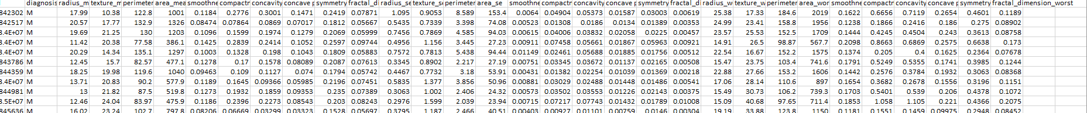
BRIEF INTRODUCTION ABOUT DATASET
We have used Wisconsin Breast Cancer (Diagnostic) dataset.
The dataset has 569 patterns (357 for benign, 212 for malignant)
Three classes (ID number, benign, malignant)
32 columns for the features
Feature for prediction is the “diagnosis” column having M(Maligant) and (B)Benign. Here,
Benign - Benign tumors grow slowly and have distinct borders.
Maligant – Malignant tumors grow quickly and have irregular borders.

Slide 7
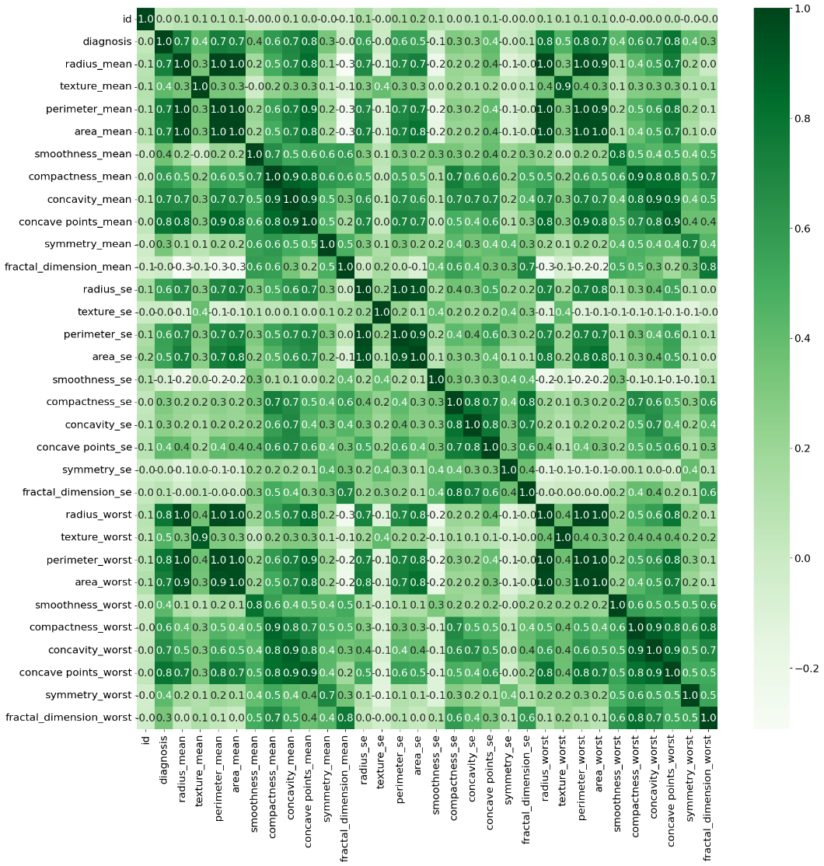
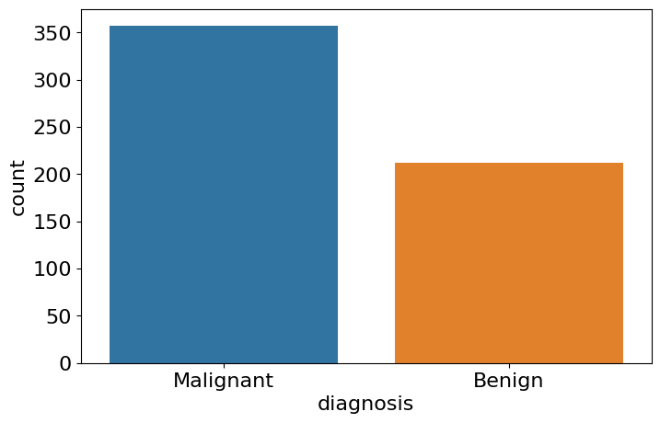
Heat map of features
Bar graph for prediction column

Slide 8
DATA PRE- PROCESSING ,CLEANSING:-
In data pre-processing ,we have removed one unnamed column.
We have used standard scaler to normalize the value between 0 and 1 resulting in removing the outliers.
We also used LabelEncoder to covert “Diagnosis” value to 0(Benign) and 1(Malign).
PCA(Principal Component Analysis) has been used to reduce the dimensionality because of containing large no of features.
In cleansing part we have nothing to do as there are no null values present in the dataset.

Slide 9
OBJECTIVE
1)To implement model using SVM:-
Support Vector Machine or SVM is one of the most popular Supervised Learning algorithms.
The goal of the SVM algorithm is to create the best line or decision boundary that can segregate n-dimensional space into classes so that we can easily put the new data point in the correct category in the future.
SVM chooses the extreme points/vectors that help in creating the hyperplane. These extreme cases are called as support vectors, and hence algorithm is termed as Support Vector Machine.

Slide 10
RESULTS OBTAINED:-
1)Accuracy score of train SVM - 96.49
2) Accuracy score of test SVM - 93.5
3)Confusion matrix - [[71 0]
[ 4 39]]
4)Precision- 97.33

Slide 11
2)To implement using KNN:-
KNN or k-NN, is a non-parametric, supervised learning classifier, which uses proximity to make classifications or predictions about the grouping of an individual data point.
K-NN algorithm assumes the similarity between the new case/data and available cases and put the new case into the category that is most similar to the available categories.

Slide 12
RESULTS OBTAINED:-
1)Accuracy score of train KNN - 94.579945799458
2) Accuracy score of test KNN - 92.5
3)Confusion matrix - [[122 7]
[5 66]]
4)Precision- 91.923

Slide 13
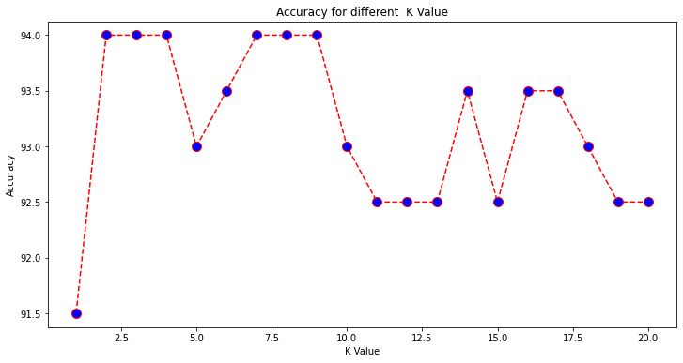
Accuracy obtained using different k values IN KNN

Slide 14
3)To implement using hybrid model using
SVM and KNN;-
For this we use stacking ensemble method but we failed to get a better accuracy instead accuracy was dropped to 51.4%
Therefore ,we implemented ANN instead.

Slide 15
4)To implement Artificial neural network (ANN)
Artificial neural network (ANN) is a computational model that consists of several processing elements that receive inputs and deliver outputs based on their predefined activation functions.

Slide 16
RESULTS OBTAINED:-
1)Accuracy score of train KNN - 98.18990155605
2) Accuracy score of test KNN - 94.73
3)Confusion matrix - [[64 3]
[3 44]]
4)Precision- 93.61

Slide 17
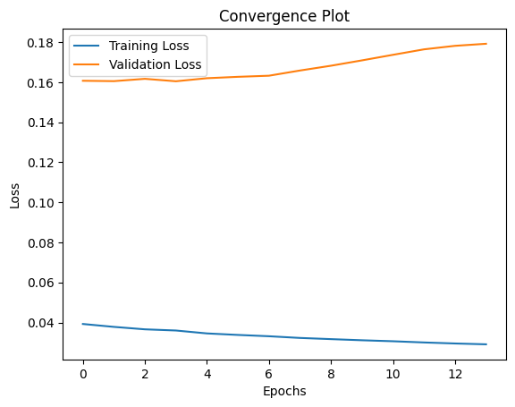
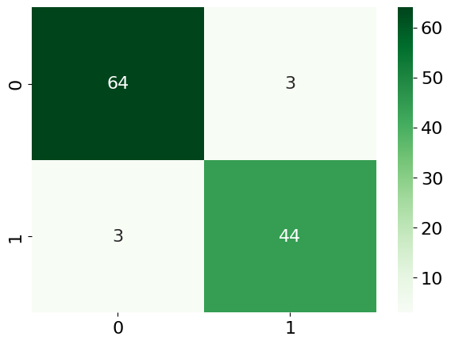
GRAPH OBTAINED:-
Loss GRAPH CONFUSION MATRIX

Slide 18
CONCLUSION
In conclusion, machine learning algorithms have shown promising results in detecting breast cancer.
Models such as KNN, SVM ,ANN have been applied to breast cancer datasets, resulting in improved accuracy, and precision on both testing and training data.
The best result was obtained using Artificial neural networks(ANN) giving accuracy greater than 99%.
Machine learning models can assist clinicians in accurately identifying breast cancer at an early stage, leading to improved patient outcomes.

Slide 19
REFERENCES
https://towardsdatascience.com/building-a-simple-machine-learning-model-onbreast-cancer-data-eca4b3b99fa3
https://www.ijert.org/research/breast-cancer-detection-using-machine-learning-techniques-IJERTV10IS070064.pdf
https://paperswithcode.com/task/breast-cancer-detection
Krizhevsky, A., Sutskever, I., & Hinton, G. E. (2017). ImageNet classification with deep convolutional neural networks. Communications of the ACM, 60(6), 84-90.
https://www.kaggle.com/datasets/uciml/breast-cancer-wisconsin-data
https://www.researchgate.net/publication/329591648_Evaluating_the_Performance_of_Machine_Learning_Techniques_in_the_Classification_of_Wisconsin_Breast_Cancer

Slide 20
THANK YOU!
QUERIES!

